Slide 1
Bayesian Network & Naive Bayes
Fabian Andres Rojas Garcia 67000277
Hugo Arturo Velásquez Albañil 6700305

Slide 2
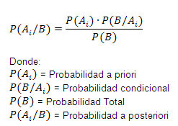
Bayesian network. [1]
Image 1.Description of the Bayes Theorem

Slide 3
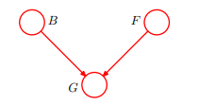
Problem description. [2]
B= state of a battery
(B = 1) = Charged
(B = 0) = Flat
F = State of fuel tank
(F = 1) = Full
(F = 0) = Empty
Image 2. three binary random variables relating to the fuel system on a car
G=state of an electric fuel gauge
(G = 1) = Full
(G = 0) = Empty

Slide 4


Probabilities given by the problem. [3]
p(B = 0) = 0.1
p(F = 0) = 0.1
Image3. Probability Battery charged and tank full
P(G = 0| B = 1, F = 1) = 0.2
P(G = 0| B = 1, F = 0) = 0.8
P(G = 0| B = 0, F = 1) = 0.8
P(G = 0| B = 0, F = 0) = 0.9
Image4. probabilities given the state of the fuel tank , battery and the fuel gauge

Slide 5

Case #1. [4]
First case
we observe the fuel gauge and discover that it reads empty.
evaluate the posterior probability of the fuel tank being empty.
Image5. we evaluated the denominator of Bayes' theorem
P(G = 0| B = 1, F = 1)P(B = 1)P(F = 1) = 0.2*0.9*0.9 = 0.162
P(G = 0| B = 1, F = 0)P(B = 1)P(F = 0) = 0.8*0.9*0.1 = 0.072
P(G = 0| B = 0, F = 1)P(B = 0)P(F = 1) = 0.8*0.1*0.9 = 0.072
P(G = 0| B = 0, F = 0)P(B = 0)P(F = 0) = 0.9*0.1*0.1 = 9X10⁻³
0.162+0.072+0.072+9X10⁻³ = 0.315

Slide 6

Case Process #1.[5]
image6. we evaluated the numerator of Bayes' theorem
p( G = 0| B = 0, F = 0) p(B) = 0.9 * 0.1 = 0.09
p( G = 0| B = 1, F = 0) p(B) = 0.8 * 0.9 = 0.72 0.09 + 0.72 = 0.81

Slide 7


Outcome of case #1. [6]
image7.posteriori result of theorem bayes

Slide 8

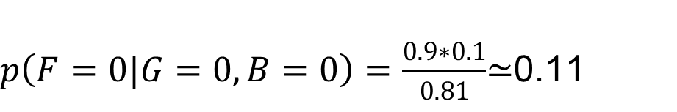
Case #2. [7]
case 2:
Battery = Flat y Fuel gauge = Empty.
The posterior probability that the fuel tank is empty given the observations.
image8.posteriori result of theorem bayes

Slide 9
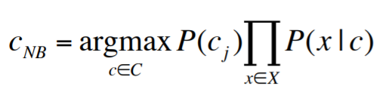
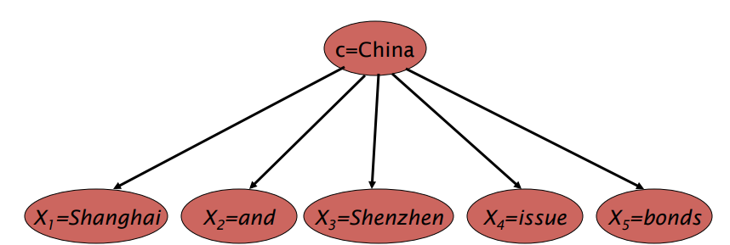
Naive Bayes. [8]
Image9.Naïve Bayes Theorem Equation
Image10.Characteristics map

Slide 10
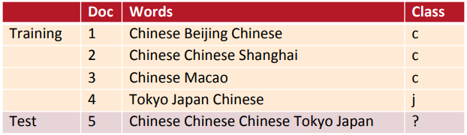

Problem data. [9]
image11.Descriptive Table Problem
image12.class probability

Slide 11
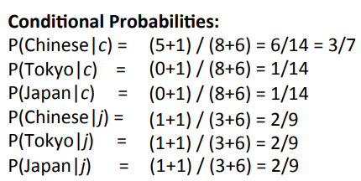
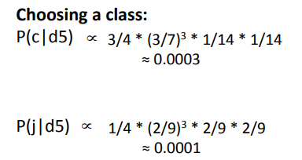
Outcome of problem. [10]
image13.Probabilities of the words
image14.Probability of the class in document 5

Slide 12
Biography. [11]
https://web.stanford.edu/class/cs124/lec/naivebayes.pdf
http://users.isr.ist.utl.pt/~wurmd/Livros/school/Bishop%20-%20Pattern%20Recognition%20And%20Machine%20Learning%20-%20Springer%20%202006.pdf

Slide 13
Thank You

Slide 14
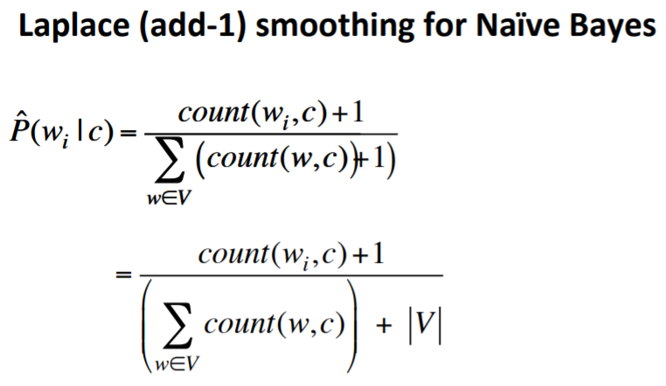
equations. [12]
image15.Probability of the class in document 5
image16.Probability of the class in document 5

